Slide 1

ECHOS OF CRIME
Crime pattern detection
W I T H J A I D E E P

Slide 2

Table of contents
01
Introduction
02
Objectives
03
Problem statement
04
Methodology
05
Data analysis
06
Outcomes
07
Furture work
08
Conclusion

Slide 3





01
Introduction
How it begins

Slide 4

Crime
Crime is increasing considerably day by day. Crime is among the main issues which is growing continuously in intensity and complexity. Crime patterns are changing constantly because of which it is difficult to explain behaviours in crime patterns. Crime is classified into various types like kidnapping, theft murder, rape etc. The law enforcement agencies collects the crime data information with the help of information technologies(IT).

Slide 5
Architecture
Data collection
Preprocessing
Data collection is a process in which information is gathered from many sources
Data pre-processing basically involves methods to remove the infinite or null values from data
Classification
Prediction
Model selection to train & test the data
Model evaluation and Metrics

Slide 6


Goals and Objectives
02
Analysis
Evaluation
Integration
To analyze historical crime data to identify recurring patterns and trends.
To evaluate the effectiveness of the developed system in enhancing crime prevention strategies.
To integrate machine learning techniques for pattern detection and anomaly detection.

Slide 7
Problem Statement
03
"Current crime detection systems often lack the sophistication to adapt to changing criminal behaviors, resulting in inefficiencies and missed opportunities for intervention."

Slide 8

Datasets
Acknowledgements
.CSV
For Data analysis -
National Crime Records Bureau (NCRB), Govt of India has published this dataset on their website and also has shared on Open Govt Data Platform India portal under Govt. Open Data License - India.
For Data classification & prediction -
Self prepared FICTIONAL data for implementation. Attributes containing are the Forensic evidences from the crime scene to predict and determine the crime as “Rape” or “Abuse”.

Slide 9

Methodology
04
Crime is classified into various types like kidnapping, theft murder, rape etc. The law enforcement agencies collects the crime data information with the help of information technologies(IT).
Methodologies I’ve used:
For Data Analysis -
EDA(Exploratory Data Analysis)
-chosen for visual representations, understanding data structures, Data quality assessment
For Data Classification & Prediction -
Decision Tree Classifier
-chosen for better interpretations, ease of use

Slide 10






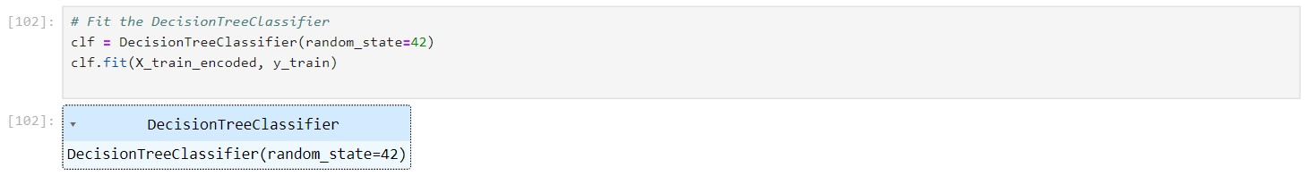

Slide 11






Crime Analysis
05
Crime analysis basically consists of procedures and methods that aims at reducing crime risk. It is a practical approach to identify and analyse crime patterns. But, major challenge for law enforcement agencies is to analyse escalating number of crime data efficiently and accurately. So it becomes a difficult challenge for crime analysts to analyse such voluminous crime data without any computational support.

Slide 12
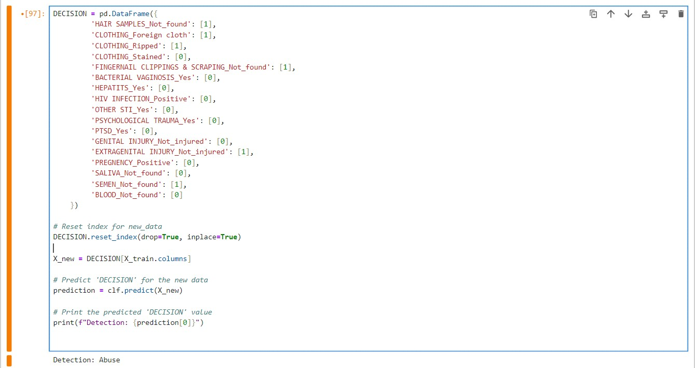
Results

Slide 13

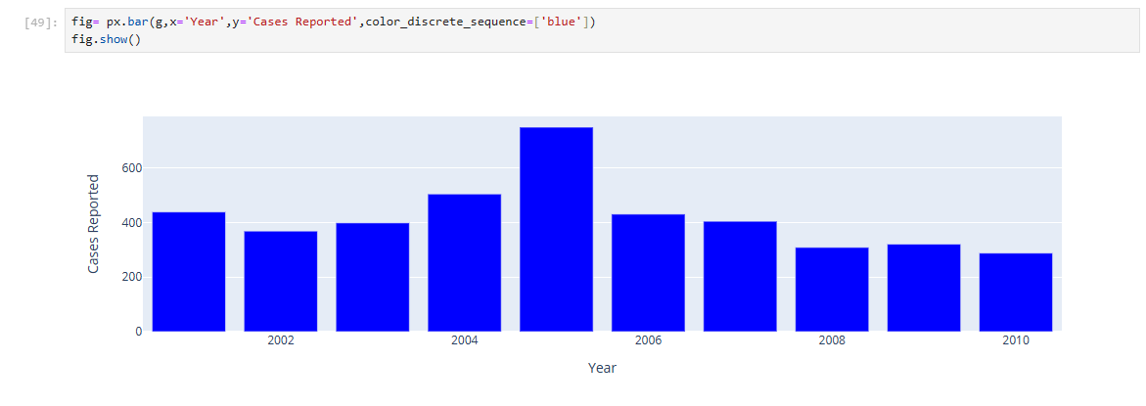
Cases reported by Year

Slide 14
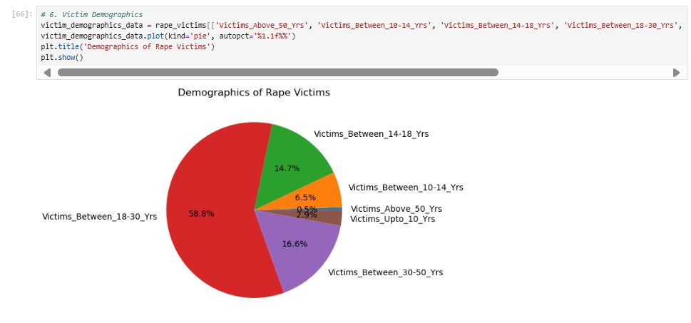

Rape Victims classified by Age

Slide 15

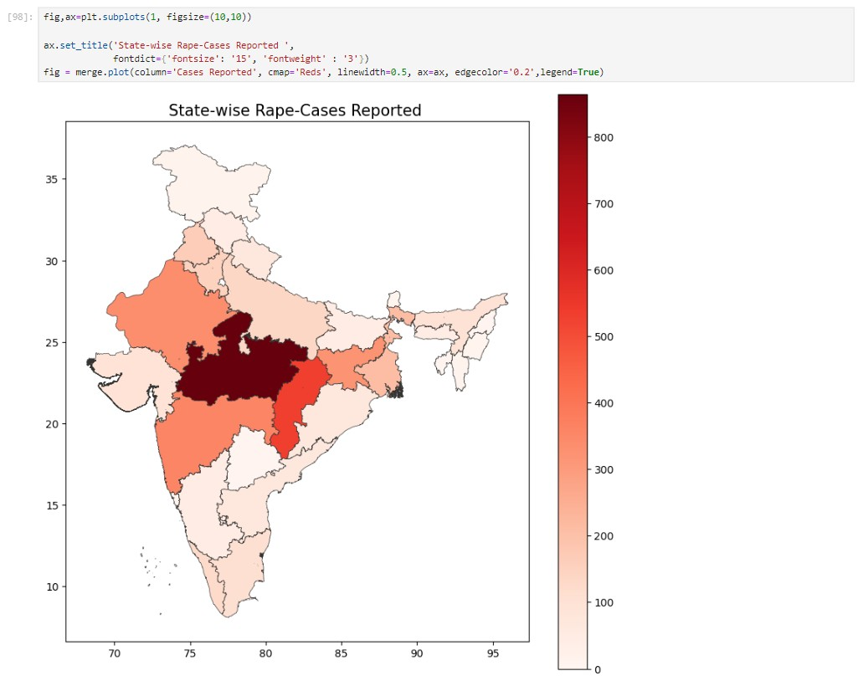
14,216
Total Cases reported

Slide 16
Outcomes
06
Enhancement
Awareness
Security
"Enhanced collaboration and information sharing among law enforcement agencies through a centralized crime pattern detection platform."
"Public awareness and engagement through transparent reporting and communication of crime trends and patterns."
"Increased community safety and security through targeted crime prevention measures informed by advanced pattern analysis."

Slide 17


Furture work
07
Integration with IoT
01 02 Predictive Analytics
Investigate opportunities to integrate with Internet of Things (IoT) devices and smart city platforms for real-time data collection and analysis.
Focus on developing predictive models that can forecast future crime trends based on historical and real-time data.
Interface Design
03
04
Collaborative Platforms
Enhance the user interface and experience to make the platform more intuitive and user-friendly for law enforcement personnel.
Create collaborative platforms that enable information sharing and coordination among various law enforcement agencies and community stakeholders.

Slide 18





Case Solved
08
The 'Echos of crime: crime pattern detection' project is a significant advancement in public safety and law enforcement, revealing hidden patterns and trends, and paving the way for a safer future for communities. Together, we can transform challenges into opportunities and pave the way for a brighter, safer tomorrow.

Slide 19




Thank You!
- J A I D E E P
2 1 S T U C H H 0 1 0 0 5 4

